Slide 1
Automobile Crash in Texas 2013
By Skye Hillhouse

Slide 2
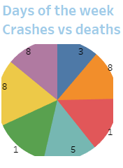

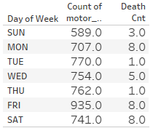
Looking at this pie chart you can take in Sunday/Tuesday/Thursday are the safest days for travel. Some of the data does leave you scratching your head. As you can see Sunday has the least amount of accidents but death are a 3. While Tuesday has a whopping 770 accidents with only 1 death.

Slide 3
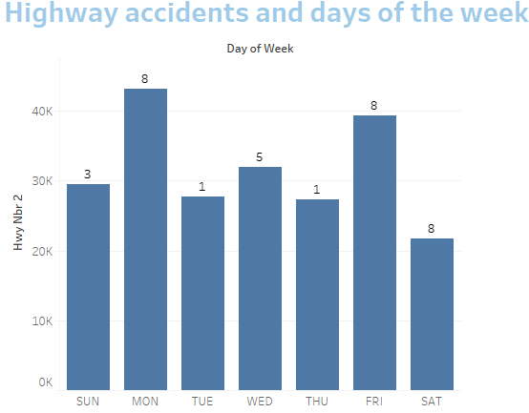
People just hate Monday’s, take the heat to the highway. Sky rocketing 40k car crashes on Mondays with 8 deaths. Friday holding Mondays hand just below 40k. Oddly Saturday has the
least amount of accidents but just as many deaths as Monday

Slide 4
Summary
Firstly driving is a privilege not a right. Keep it safe and see another day. This data at a glance shows us car accidents by days of the week and fatalities in the state of Texas 2013, also how many of those accident have accorded on the highway. It’s safe to say Sunday/Tuesday/Thursday are among the safest days for traveling.

